Slide 1
Computer Organization & Design —The Hardware/Software Interface
Chapter 4-1 Processor Design

Slide 2
重要通知
Mi-term test ： May９
Contents： start to single-cycle CPU design

Slide 3
Contents
4.1 Introduction
4.2 Logic Design Conventions
4.3 Building a datapath
4.4 A Simple Implementation Scheme
Single cycle CPU
Multiple cycle CPU
4.5 An Overview of Pipelining

Slide 4
4.1 Introduction
We‘ll look at an implementation of the MIPS
Simplified to contain only:
memory-reference instructions: lw, sw
arithmetic-logical instructions: add, sub, and, or, slt
control flow instructions: beq, j
Generic Implementation:
use the program counter (PC) to supply instruction address
get the instruction from memory
read registers
use the instruction to decide exactly what to do
What are steps?
How many FUN.?

Slide 5
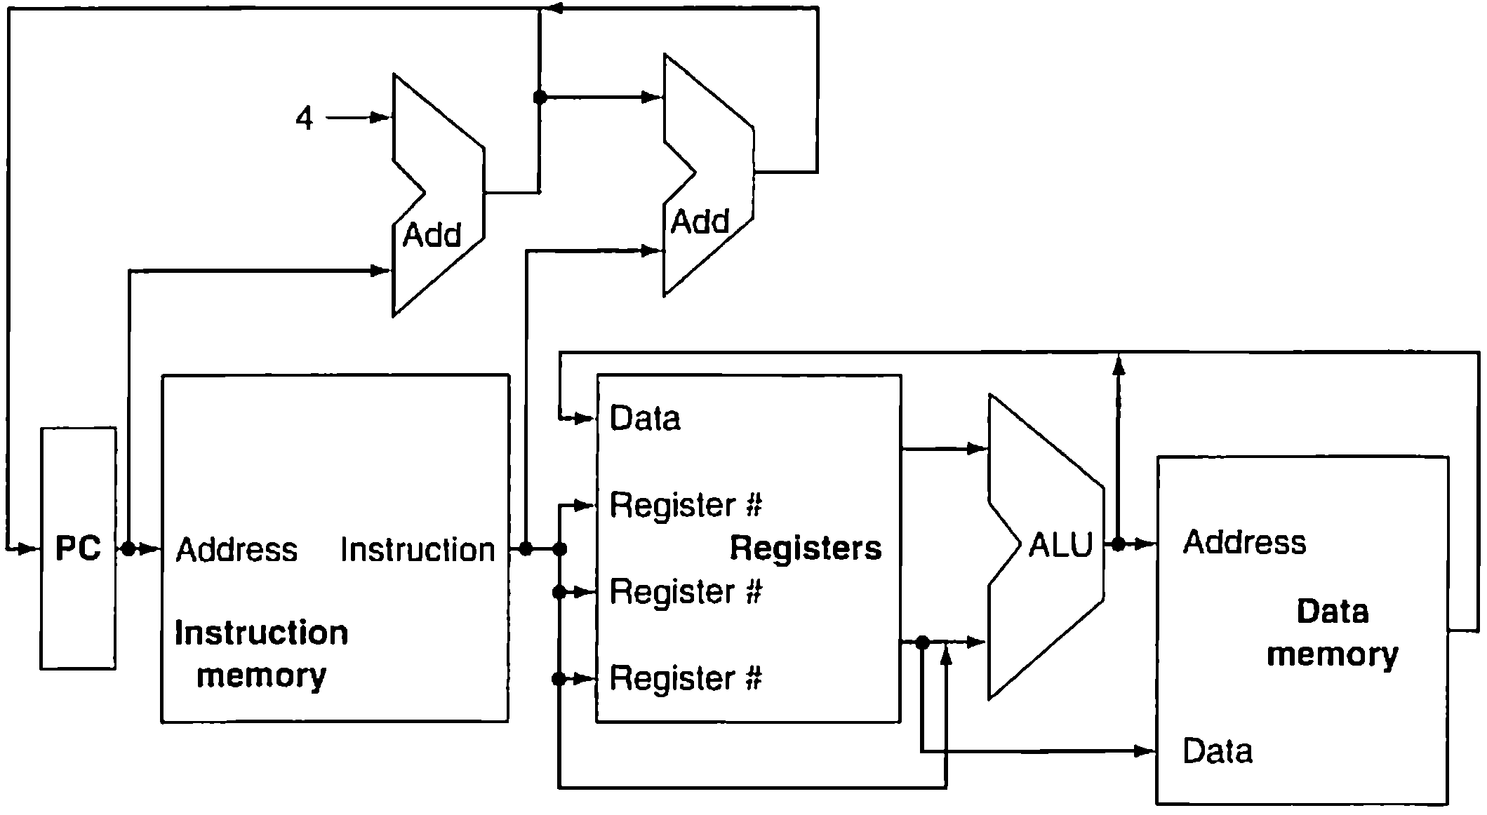
An abstract view of the implementation of MIPS

Slide 6
Contents
4.1 Introduction
4.2 Logic Design Conventions
4.3 Building a datapath
4.4 A Simple Implementation Scheme
4.5 An Overview of Pipelining

Slide 7
State Elements
Unclocked vs. Clocked
Clocks used in synchronous logic
when should an element that contains state be updated?
falling edge
cycle time
rising edge

Slide 8
Our Implementation
An edge triggered methodology
Typical execution:
read contents of some state elements,
send values through some combinational logic
write results to one or more state elements

Slide 9
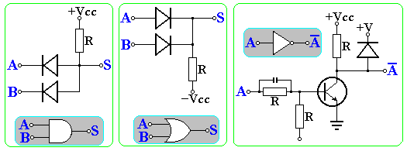
Basic elements
Basic logic gate。
AND：S=A•B
OR ：S=A+B
NOT：S=~A
A | B | A•B | A+B | ~A
0 | 0 | 0 | 0 | 1
0 | 1 | 0 | 1 | 1
1 | 0 | 0 | 1 | 0
1 | 1 | 1 | 1 | 0

Slide 10
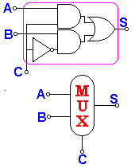
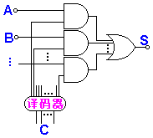
MUX
多路开关：有若干个输入，由控制端决定那一路输入将输出。
经常是多路并行。
C | S
0 | A
1 | B

Slide 11
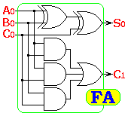
Adder
Half adder：
Full adder：S=A+B
Input: A, B, C0. Output: Sum, CarryOut
S = A ⊕ B ⊕ C
C₊₁= A•B + B•C + C•A
A | 0 | 0 | 1 | 1
B | 0 | 1 | 0 | 1
S | 0 | 1 | 1 | 0
A | 0 | 0 | 1 | 1 | 0 | 0 | 1 | 1
B | 0 | 1 | 0 | 1 | 0 | 1 | 0 | 1
C | 0 | 0 | 0 | 0 | 1 | 1 | 1 | 1
S | 0 | 1 | 1 | 0 | 1 | 0 | 0 | 1
C₊₁ | 0 | 0 | 0 | 1 | 0 | 1 | 1 | 1

Slide 12
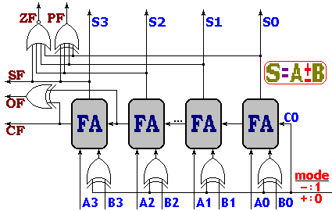
串行进位加法器
4位串行进位加法器：S=A+B
各位串行进行。
同时根据结果产生各种标记状态。
A
32
+
S=A+B
B
32
Operation

Slide 13
Adder
32-bit Adder
A
32
+
S=A+B
B
32
Operation

Slide 14
ALU
算术逻辑运算器ALU：即运算器
5 Operations
“Set on less than”：
if A<B then Result=1；
else Result=0。
Operation | Function
000 | And
001 | Or
010 | Add
110 | Sub
111 | Slt
Binvert
CarryIn
Operation
A
A
32
00
01
Result
Result
ALU
B
0
10
1
B
32
Less
11
3
CarryOut
Operation

Slide 15
ALU Control
ALUop与Func联合对ALU的控制

Slide 16
ALU Control
ALU控制：
ALU由ALUcontrol控制：ALUcontrol由ALUop和指令的低6位(5-0)联合产生ALU控制码。
这样的好处在于分级控制，对于用的最多的加、减操作，系统只需给出两位的ALUop即可。
A
32
zero
ALU
Result
B
32
32
Operation
3
ALU
control
Func
[5-0]
2
ALUop

Slide 17
REGISTER
Register
State element。
Can be controled by Write signal.
Write
Read：
Out=Register
In
Out
In
Out
Clock cycle
Write：
Register=In
Register
Register

Slide 18
Memory
存储器：
可分为指令存储器与数据存储器；
指令存储器设为只读；输入指令地址，输出指令。
数据存储器可以读写，由MemRead和MemWrite控制。按地址读出数据输出，或将写数据写入地址所指存储器单元。
MemWrite
Instruction
Address
Address
Read
data
Instruction
Write
data
Instruction
memory
Data
memory
MemRead

Slide 19
D 触发器
S
C | D | S | R | Q(t + 1)
0 | X | X | X | hold
1 | 0 | 0 | 1 | Q=0：reset
1 | 1 | 1 | 0 | Q=1：reset
D
Q
C
Q
R
C | D | Q(t + 1)
0 | X | hold
1 | 0 | Q=0：reset
1 | 1 | Q=1：set
D
Q
C
Q
Truth table
Symbol of Latch

Slide 20
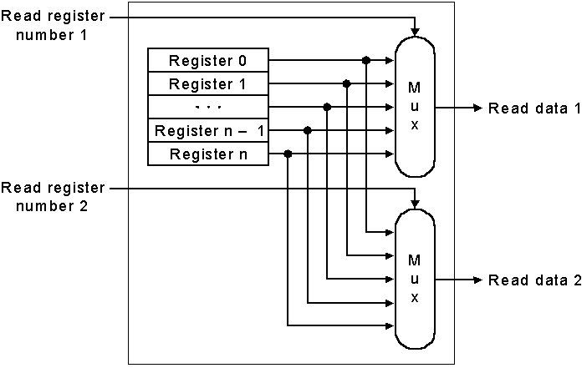
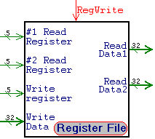
Register File
Register File：
32 32-bit Registers；
Input: 2 32-bit;
Output: 32-bit data, 32-bit register number;
Register write control。

Slide 21
Register File
Write Register:
we still use the real clock to determine when to write
Write
0
C
Register
1
D
Register number
decoder
C
Register 1
n-1
D
n
C
Register n-1
D
C
Register n
Register data
D

Slide 22
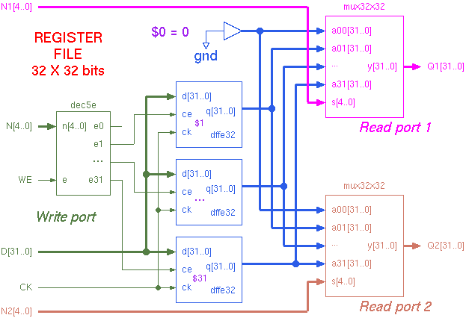
Register File

Slide 23
32×32bits寄存器组硬件描述
Module regs(clk, rst,reg_Rd_addr_A, reg_Rt_addr_B, reg_Wt_addr, wdata, we, rdata_A, rdata_B);
input clk, rst, we;
input [4:0] reg_Rd_addr_A, reg_Rt_addr_B, reg_Wt_addr;
input [31:0] wdata;
output [31:0] rdata_A, rdata_B;
reg [31:0] register [1:31]; // r1 - r31
integer i;
assign rdata_A = (reg_Rd_addr_A == 0)? 0 : register[reg_Rd_addr_A]; // read
assign rdata_B = (reg_Rt_addr_B == 0)? 0 : register[reg_Rt_addr_B]; // read
always @(posedge clk or posedge rst)
begin
if (rst==1) begin // reset
for (i=1; i<32; i=i+1)
register[i] <= 0;
end
else begin
if ((reg_Wt_addr != 0) && (we == 1)) // write
register[reg_Wt_addr] <= wdata;
end
end
endmodule

Slide 24
32个Register的功用
寄存器组有32个32位寄存器，其功用分配如下表：

Slide 25
The other elements
Sign Extend：
将16位的补码表示的有符号立即数，扩展为32位。
方法：只需重复符号位即可。
Shift：
Shift 2 bits left。
方法：将输入高移2位接输出，输出的低两位接0。
16
Sign
extend
32
Shift
left 2
D31
.
.
.
D16
D15
D14
.
.
.
D00
D31
D30
D29
.
.
.
.
.
.
D02
D01
D00
D31
D30
D29
.
.
.
.
.
.
D02
D01
D00
D15
D14
.
.
.
D00

Slide 26
Simple Implementation
Include the functional units we need for each instruction
A
L
U
c
o
n
t
r
o
5
R
3
l
e
a
r
d
e
g
i
s
t
e
r
1
R
e
a
d
d
a
t
R
5
a
1
e
g
i
s
t
e
r
R
e
a
d
Z
e
r
r
o
e
g
i
s
t
e
n
r
2
u
m
b
e
r
s
R
e
g
i
s
t
e
r
s
D
a
t
a
A
L
U
A
L
5
W
U
r
i
t
e
r
Why do we need this stuff?
e
s
u
l
r
t
e
g
i
s
t
e
r
R
e
a
d
d
a
t
W
a
2
r
i
t
D
e
a
t
a
d
a
t
a
R
e
g
W
r
i
t
e
a
.
R
e
g
i
s
t
e
r
s
b
.
A
L
U

Slide 27
Instruction types
R type
Opcode rs rt rd shamt function
I type
Opcode rs rt immediate
J type
Opcode Address

Slide 28
Contents
4.1 Introduction
4.2 Logic Design Conventions
4.3 Building a datapath
4.4 A Simple Implementation Scheme
4.5 An Overview of Pipelining

Slide 29
Instruction fetching three elements
R
e
a
d
a
d
d
r
e
s
s
I
n
s
t
r
u
c
t
i
o
n
PC
Add Sum
I
n
s
t
r
u
c
t
i
o
n
m
e
m
o
r
y
Instruction memory
Program counter
Adder

Slide 30
Instruction fetching unit
A
d
d
4
P
C
R
e
a
d
a
d
d
r
e
s
s
CPU
I
n
s
t
r
u
c
t
i
o
n
I
n
s
t
r
u
c
t
i
o
n
m
e
m
o
r
y

Slide 31
More Implementation Details
Abstract / Simplified View:

Slide 32
R type Instruction & Data stream
op(6)
Bnegate | op | function
0 | 00 | and
0 | 01 | Or
0 | 10 | Add
1 | 10 | Sub
1 | 11 | Slt
control
ALU operation
rs(5)
rt(5)
bit₂₁₋₂₅
RegWrite
rs
Registers
3
Read reg. address1
bit₁₆₋₂₀
Read data1
rd(5)
rt
Read reg. address2
ALU
Zero
bit₁₁₋₁₅
shamt
rd
Write reg. address
ALU result
Read data2
Write data
func(6)
32bits data

Slide 33
I type Instruction & Data stream
Sw $t0, 200($s2)
control
bit₂₁₋₂₅
RegWrite
3
ALU operation
rs
Registers
bit₁₆₋₂₀
Read reg. address1
Read data1
rt
Read reg. address2
ALU
Zero
MenWrite
op(6)
rs(5)
rt(5)
Immediate data
rt
Write reg. address
ALU result
address
Read data2
Write data
Read data
Data
Memory
bit₀₋₁₅
Sign extend
Write data
32
MenRead
16
32bits data
lw $t0, 200($s2)
if $s2=1000，it will load word in element number 1200 to $t0

Slide 34
I type Instruction & Data stream of beq
PC+4 from instructiondatapath
ADD
To PC
Shift
left 2
bit₂₁₋₂₅
RegWrite
rs
Registers
3
ALU operation
bit₁₆₋₂₀
Read reg. address1
Read data1
rt
Read reg. address2
ALU
Zero
op(6)
rs(5)
rt(5)
offset
rt
Write reg. address
ALU result
Read data2
Write data
bit₀₋₁₅
Sign extend
32
16

Slide 35
combine the implementation R-type and I type

Slide 36
Contents
4.1 Introduction
4.2 Logic Design Conventions
4.3 Building a datapath
4.4 A Simple Implementation Scheme
4.5 An Overview of Pipelining

Slide 37
Building the Datapath
Use multiplexors to stitch them together
0
1
0
0
1
1
Note : control signals Page 306 F4.15

Slide 38
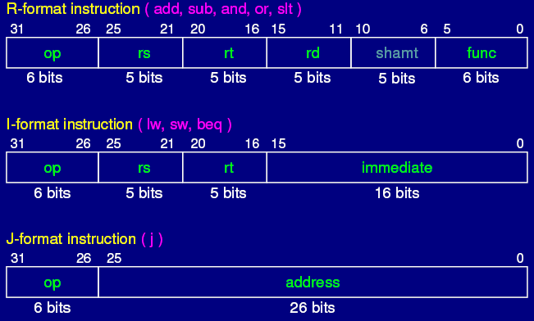
Control
Analyse for cause and effect
Information comes from the 32 bits of the instruction
Selecting the operations to perform (ALU, read/write, etc.)
Controlling the flow of data (multiplexor inputs)
ALU's operation based on instruction type and function code

Slide 39
Instruction Code
jal ?????? Address r31←PC+4
lui ?????? 00000 rt immediate
shift 000000 00000 rt rd shamt ??????

Slide 40
What should ALU do ?
e.g. what should the ALU do with these instructions
Example: lw $1, 100($2) OP rs rt 16 bit displacement
ALU control input
3 -types
Why is the code for subtract 110 and not 011?
ALU op
lw
sw
R
(100011)35
2
1
100
00
01
10
(101011)43
2
1
100
000000(00)
rs(5)
rt(5)
rd(5)
shamt
func(6)
B negate | op | function
0 | 00 | and
0 | 01 | Or
0 | 10 | Add
1 | 10 | Sub
1 | 11 | Slt

Slide 41
Scheme of Controller
2-level decoder
op(6)
rs(5)
rt(5)
rd(5)
shamt
func(6)
First
Main
decoder
ALU
Decoder
Second
ALU operation(3)
ALU op(2)
instruction op code
(6)
Signals for Other
Components (7)

Slide 42
The ALU control is where and other signals(7)
0
1
0
0
1
1

Slide 43
signals for datapath Defined 7+2 control (p. 307) f4.16
Signal name | Effect when deasserted(=0) | Effect when asserted(=1)
RegDst | Select register destination number from the rt(20:16) when WR | Select register destination number from the rd(15:11) when WB
RegWrite | None | Register destination input is written with the value on the Write data input
ALUScr | The second ALU operand come from the second register file output (Read data 2) | The second ALU operand is the sign-extended lower 16 bits of the instruction..
PCSrc | The PC is replaced by the output of the adder that computers the value PC+4 | The PC is replaced by the output of the adder that computers the branch target.
MemRead | None | Data memory contents designated by the address input are put on the Read data output.
MemWrite | None | Data memory contents designated by the address input are replaced by value on the Write data input.
MemtoReg | The value fed to register Write data input comes from the Alu | The value fed to the register Write data input comes from the data memory.

Slide 44
Designing the ALU decoder (Second level)
Must describe hardware to compute 3-bit ALU conrol input
Instruction opcode | ALUOp | Instruction operation | Funct field | Desired ALU action | ALU control Input
LW | 00 | Load word | xxxxxx | Load word | 0010
SW | 00 | Store word | xxxxxx | Store word | 0010
Beq | 01 | branch equal | xxxxxx | branch equal | 0110
R-type | 10 | add | 100000 | add | 0010
R-type | 10 | subtract | 100010 | subtract | 0110
R-type | 10 | AND | 100100 | AND | 0000
R-type | 10 | OR | 100101 | OR | 0001
R-type | 10 | Set on less than | 101010 | Set on less than | 0111

Slide 45
Truth Table for ALU decoder
Describe it using a truth table (can turn into gates):
don’t care

Slide 46
**The ALU control signals---logic circuit
F₁
F₁F₀
F₃F₂
0 | x | x | 1
0 | 0 | x | x
x | x | x | x
x | x | x | 1
F₁F₀
F₃F₂
F₂
1 | x | x | 1
0 | 0 | x | X
x | x | x | X
1 | x | x | 1
F₁F₀
F₃F₂
0 | x | x | 0
0 | 1 | x | X
x | x | x | X
x | x | x | 1
F₃
F₀

Slide 47
Designing the Main Control Unit (First level)
Main Control Unit function
ALU op (2)
Divided 7 control signals into 2 groups
4 Mux
3 R/W
ALU
control
ALU op (2)
Instruction op code (6)
Mux (4)
R/W (3)

Slide 48
Truth Table for Main decoder

Slide 49
Circuitry of main Controller
Simple combinational logic (truth tables)
opcode | output
000000 | R-format
100011 | lw
101011 | sw
000100 | beq
L/S 00
beq 01
R-type 10

Slide 50
Controller Implementation
SrcB=
MRead=LW+LH+LB
MWrite=SW+SH+SB
M2Reg=LW+LH+LB
RegDes=ALURI+LW+LUI (rt)
Wreg=ALURR+ALURI+Load
+JAL+LUI+shift
=~(Branch + J + JR + Store)
Taken=Beq*Zero + Bne*~Zero
SrcA=SLL + SRL = shift
…
controller
ALURI+LW+SW+SHIFT
ALUop
opcode6
And
Or
ALU-R-R
ALU-R-I
LW
SW
BEQ
Func6
BNE
J
JAL
JR
Zero
LUI
SHIFT

Slide 51
Our Simple Control Structure
All of the logic is combinational
We wait for everything to settle down, and the right thing to be done
ALU might not produce right answer? right away
we use write signals along with clock to determine when to write
Cycle time determined by length of the longest path
Instruction n
Instruction n+1
We are ignoring some details like setup and hold times

Slide 52
The simple Datapath with the control unit
Instruction [25-0]
Shift
left 2
jump address[31-0]
0
M
U
X
1
1
M
U
X
0
26
28
PC+4[31-28]
Add
ALU
result
Shift
left 2
Add
4
Control
RegDst
Branch
MemRead
MemtoRead
ALUOp
MemWrite
ALUSrc
RegWrite
jump
Instruction [31-26]
pc
Read
address
Instruction
[31-0]
Instruction [25-21]
Read
register 1
Read
data 1
Instruction
memory
Instruction [20-16]
Zero
Read
register 2
ALU
Address
1
M
U
X
0
0
M
U
X
1
ALU
result
Read
data
Write
register
Read
data 2
0
M
U
X
1
R-type
Op | rs | rt | rd | shamt | Funct
Write
data
Data
memory
Instruction [15-11]
Registers
Write
data
I-type
Op | rs | rt | Immediate
16
Sign
extend
32
ALU
control
Instruction [15-0]
Jump-type
Op | address
Instruction [5-0]

Slide 53
The Datapath in operation for R-type
Instruction [25-0]
Shift
left 2
jump address[31-0]
0
M
U
X
1
1
M
U
X
0
26
28
PC+4[31-28]
Add
ALU
result
Shift
left 2
Add
4
Control
RegDst
Branch
MemRead
MemtoRead
ALUOp
MemWrite
ALUSrc
RegWrite
jump
Instruction [31-26]
pc
Read
address
Instruction
[31-0]
Instruction [25-21]
Read
register 1
Read
data 1
Instruction
memory
Instruction [20-16]
Zero
Read
register 2
ALU
Address
1
M
U
X
0
0
M
U
X
1
ALU
result
Read
data
add sub and or slt
Write
register
Read
data 2
0
M
U
X
1
R-type
Op | rs | rt | rd | shamt | Funct
Write
data
Data
memory
Instruction [15-11]
Registers
Write
data
I-type
Op | rs | rt | Immediate
16
Sign
extend
32
ALU
control
Instruction [15-0]
Jump-type
Op | address
Instruction [5-0]

Slide 54
The Datapath in operation for load
Instruction [25-0]
Shift
left 2
jump address[31-0]
0
M
U
X
1
1
M
U
X
0
26
28
PC+4[31-28]
Add
ALU
result
Shift
left 2
Add
4
Control
RegDst
Branch
MemRead
MemtoRead
ALUOp
MemWrite
ALUSrc
RegWrite
jump
Instruction [31-26]
pc
Read
address
Instruction
[31-0]
Instruction [25-21]
Read
register 1
Read
data 1
Instruction
memory
Instruction [20-16]
Zero
Read
register 2
ALU
Address
1
M
U
X
0
0
M
U
X
1
ALU
result
Read
data
load instruction
Write
register
Read
data 2
0
M
U
X
1
R-type
Op | rs | rt | rd | shamt | Funct
Write
data
Data
memory
Instruction [15-11]
Registers
Write
data
I-type
Op | rs | rt | Immediate
16
Sign
extend
32
ALU
control
Instruction [15-0]
Jump-type
Op | address
Instruction [5-0]

Slide 55
The Datapath in operation for SW
Instruction [25-0]
Shift
left 2
jump address[31-0]
0
M
U
X
1
1
M
U
X
0
26
28
PC+4[31-28]
Add
ALU
result
Shift
left 2
Add
4
Control
RegDst
Branch
MemRead
MemtoRead
ALUOp
MemWrite
ALUSrc
RegWrite
jump
Instruction [31-26]
pc
Read
address
Instruction
[31-0]
Instruction [25-21]
Read
register 1
Read
data 1
Instruction
memory
Instruction [20-16]
Zero
Read
register 2
ALU
Address
1
M
U
X
0
0
M
U
X
1
ALU
result
Read
data
store instruction
Write
register
Read
data 2
0
M
U
X
1
R-type
Op | rs | rt | rd | shamt | Funct
Write
data
Data
memory
Instruction [15-11]
Registers
Write
data
I-type
Op | rs | rt | Immediate
16
Sign
extend
32
ALU
control
Instruction [15-0]
Jump-type
Op | address
Instruction [5-0]

Slide 56
The Datapath in operation for BEQ
Instruction [25-0]
Shift
left 2
jump address[31-0]
0
M
U
X
1
1
M
U
X
0
26
28
PC+4[31-28]
Add
ALU
result
Shift
left 2
Add
4
Control
RegDst
Branch
MemRead
MemtoRead
ALUOp
MemWrite
ALUSrc
RegWrite
jump
Instruction [31-26]
pc
Read
address
Instruction
[31-0]
Instruction [25-21]
Read
register 1
Read
data 1
Instruction
memory
Instruction [20-16]
Zero
Read
register 2
ALU
Address
1
M
U
X
0
0
M
U
X
1
ALU
result
Read
data
beq instruction
Write
register
Read
data 2
0
M
U
X
1
R-type
Op | rs | rt | rd | shamt | Funct
Write
data
Data
memory
Instruction [15-11]
Registers
Write
data
I-type
Op | rs | rt | Immediate
16
Sign
extend
32
ALU
control
Instruction [15-0]
Jump-type
Op | address
Instruction [5-0]

Slide 57
j instruction
instruction format
j Label
Implementation
pc = pc_{28~31} ## 26bits-address × 4
(000010)2
26 bits address

Slide 58
The Datapath in operation for j
Instruction [25-0]
Shift
left 2
jump address[31-0]
0
M
U
X
1
1
M
U
X
0
26
28
PC+4[31-28]
Add
ALU
result
Shift
left 2
Add
4
Control
RegDst
Branch
MemRead
MemtoRead
ALUOp
MemWrite
ALUSrc
RegWrite
jump
Instruction [31-26]
pc
Read
address
Instruction
[31-0]
Instruction [25-21]
Read
register 1
Read
data 1
Instruction
memory
Instruction [20-16]
Zero
Read
register 2
ALU
Address
0
M
U
X
1
0
M
U
X
1
ALU
result
Read
data
jump instruction
Write
register
Read
data 2
0
M
U
X
1
R-type
Op | rs | rt | rd | shamt | Funct
Write
data
Data
memory
Instruction [15-11]
Registers
Write
data
I-type
Op | rs | rt | Immediate
16
Sign
extend
32
ALU
control
Instruction [15-0]
Jump-type
Op | address
Instruction [5-0]

Slide 59
Single Cycle Implementation performance for lw
Calculate cycle time assuming negligible delays except:
memory (2ns), ALU and adders (2ns), register file access (1ns)
2ns
1+1=ns
2ns
2ns

Slide 60
The time sequence in single-cycle implementation
PC

Slide 61
ISE Block RAM design
http://wenku.baidu.com/view/5231ba778e9951e79b892746.html

Slide 62
**Performance in Single Cycle Implementation
Let’s see the following table:
Instruction class | Instruction memory | Register read | ALU | Data memory | Register write | Total
R-format | 2 | 1 | 2 |  | 1 | 6 ns
Load word | 2 | 1 | 2 | 2 | 1 | 8 ns
Store word | 2 | 1 | 2 | 2 |  | 7 ns
Branch | 2 | 1 | 2 |  |  | 5 ns
Jump | 2 |  |  |  |  | 2 ns
The conclusion:
Different instructions needs different time.
The clock cycle must meet the need of the slowest instruction. So, some time will be wasted.

Slide 63

The CPU Performance Equation
CPU _{time}=IC* CPI* CC

Slide 64



Slide 65
CPU performance is dependent upon three characteristics:
clock cycle ( CC )
clock cycles per instruction ( CPI )
and instruction count (IC ).
It is difficult to change one parameter in complete isolation from others because the basic technologies involved in changing each characteristic are interdependent:
Clock cycle time—Hardware technology and organization
Clock cycle time—Hardware technology and organization
Instruction count—Instruction set architecture and compiler technology

Slide 66


MIPS (million instruction per second)
The bigger the MIPS, the faster the machine.
Three problems with MIPS:
MIPS is dependent on the instruction set, making it difficult to compare MIPS of computers with different instruction sets.
MIPS varies between programs on the same computer.
Most importantly, MIPS can vary inversely to performance!

Slide 67
Single Cycle Problems
what if we had a more complicated instruction like floating point?
If so, the waste of time will be much more large.
wasteful of area. The reason is the following:
Let’s see the instruction ‘mult’. This instruction needs to use the ALU repeatedly. But, in the single cycle implementation, one ALU can be used only once in one clock cycle. So,the instruction ‘mult’ will need many ALUs. The CPU will be very large.

Slide 68
One Solution for Single Cycle Problems
One Solution:
Use a smaller cycle time
Let different instructions take different numbers of cycles
a Multicycle datapath:

Slide 69
contents
4.1 Introduction
4.2 Logic Design Conventions
4.3 Building a datapath
4.4 A Simple Implementation Scheme
4.5 A Multicycle Implementation
4.5 Microprogramming
4.6 Exception

Slide 70
END

